Slide 1
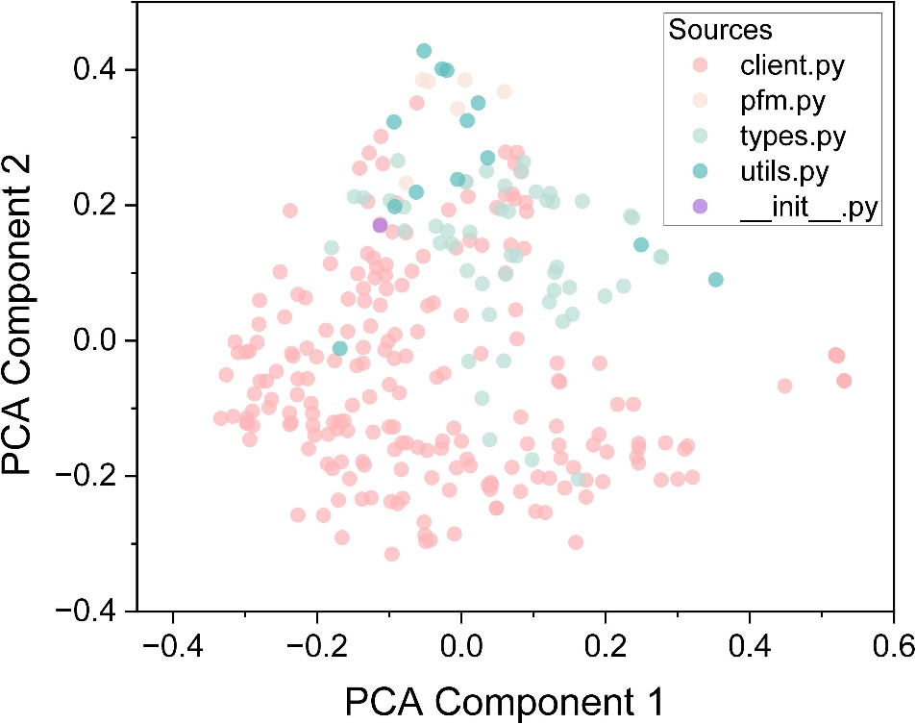

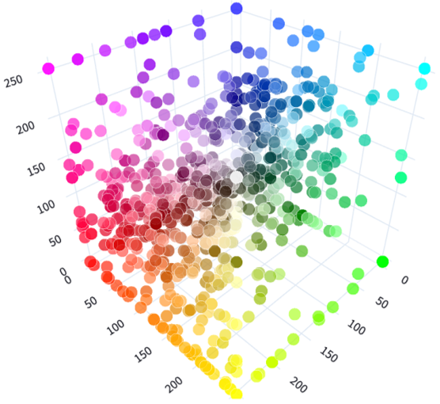
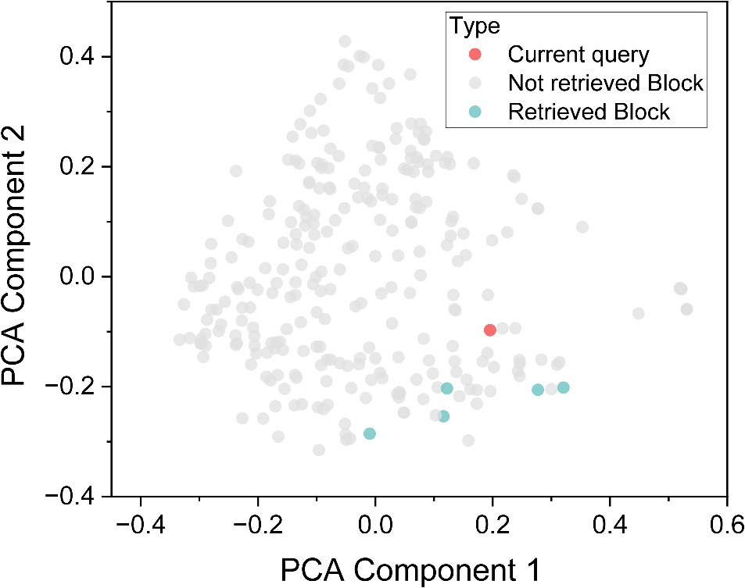

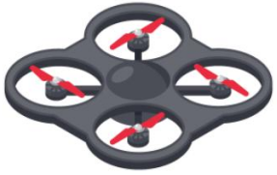

After taking off to 10M, fly forward 50M, rotate clockwise 45 degrees and fly 10M, then land.
①
takeoffAsync()
②
moveToZAsync()
moveByVelocityZAsync()
⑦
rotateByYawRateAsync()
(b) Vector database built from AirSim API
landAsync()
③
⑥
Tasks completed……
④
⑤
(a) The flow of RAG
(c) Retrieved blocks of relevant information

Slide 2
After taking off to 10M, fly forward 50M, rotate clockwise 45 degrees and fly 10M, then land.
@tool
vector_search
takeoffAsync()
moveToZAsync()
moveByVelocityZAsync()
rotateByYawRateAsync()
landAsync()
Coder
Code execution
in AirSim
Complete code with
Explanation
…
@tool
code_executor
Supervisor
(a) The flow of RAG
(b) Vector database built from AirSim API
(c) Retrieved blocks of relevant information

Slide 3
__start__
__end__
end
@tool
object_detection
Supervisor
@tool
vector_search
Tracker
Coder
Tracker
Coder
@tool
locolization
@tool
code_executor
@tool
web_search

Slide 5
After taking off to 10M, fly forward 50M, rotate clockwise 45 degrees and fly 10M, then land.
takeoffAsync()
@tool
vector_search
moveToZAsync()
moveByVelocityZAsync()
rotateByYawRateAsync()
landAsync()
Coder
Code execution
in AirSim
Complete code with
Explanation
…
@tool
code_executor
Supervisor
(a) The flow of RAG
(b) Vector database built from AirSim API
(c) Retrieved blocks of relevant information

Slide 6
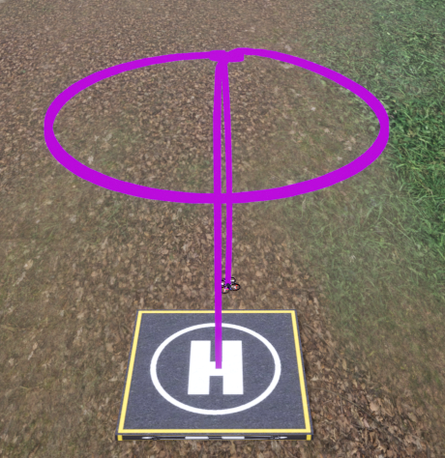
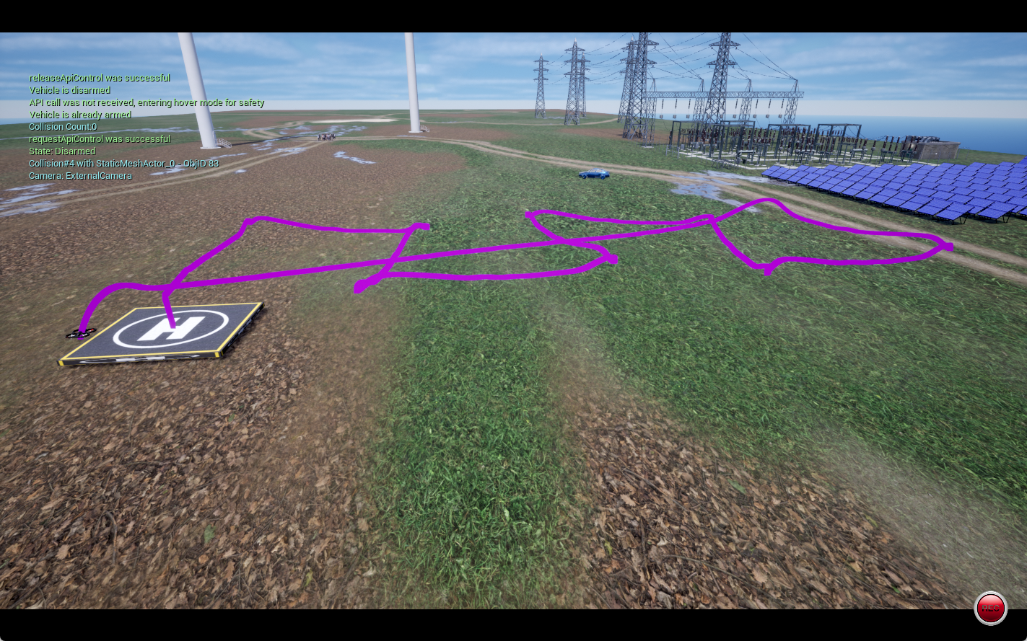
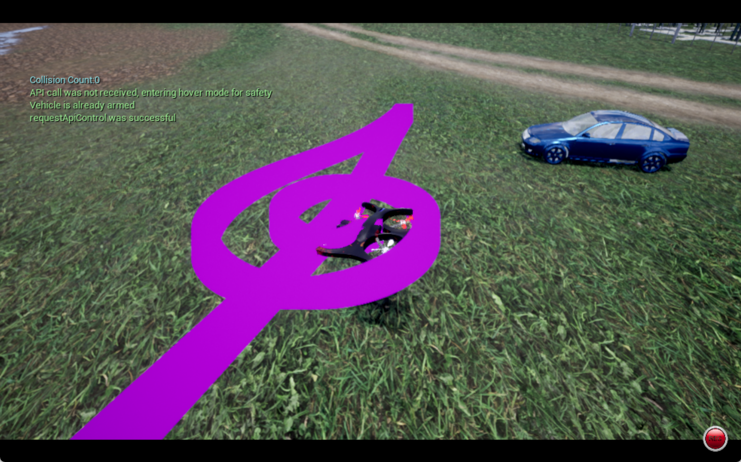
(a) Go three times in a circular orbit
(b) Follow a zigzag trajectory con- sisting of 9 segments
(c) Detect the position of the blue car, hover near it after approaching

